Slide 1
DevOps: For SW-DEVs
A HIGH LEVEL OVERVIEW OF THE “OPS” PART OF DEVOPS FOR SOFTWARE ENGINEERS

Slide 2
Topics
Deployment
Logging
Monitoring
Configuration Management
Collaboration between Developers and Operators

Slide 3
Deployment
Simplest case: xcopy / rsync based deployment
Assuming we have a server that already has linux + nginx + php + mysql (typically called LEMP), we can just rsync files from a local directory (git working tree) to the server. (We’ll come back to server preparation at a later point in the presentation)
Live Demo:
git clone git@github.com:media-net/devops-app1 app1
cd app1
rsync -avhz $PWD class1.mnet.website:/var/www/demo1
#site is now available from http://class1.mnet.website/demo1
…
We can repeat this each time we change the code … but there are many issues with this approach...
Notes:
-- can we do a live demo?
Need to have a server + app.
Should be able to xcopy files to server and show changes.

Slide 4
Server Preparation
Ansible / Puppet
Why
Because a server in the preliminarily state has just OS installed and in order to run a full fledged application, certains environment has to be created so that the app can run without an issue.
How
Have an automated shell script to update/install every tool/package required.
Have a configuration management server in charge which takes care of the server setup without an intervention required on fleet of servers.
What
Create a certain environment, install specific packages with specific version and even control the app.

Slide 5
Issues with Simple Deployment
This deployment has a number of Issues:
Version control
Access management
Credential management
Audit Trail
Processes / cron jobs need to be restarted?
Atomicity of deploy
Distributed Systems (most modern software)
Solution to above: Continuous Integration & Deployment (CI / CD)

Slide 6
A little better...
git-hook based deploy:
Git (and most git hosts like gitlab, github) support notifications / hooks that can be called once a commit is made. We can use these hooks to initiate a build (or deployment).
Let’s take a very trivial case.
Add a remote to your local git repo
`git add remote web git@class1.mnet.website:sitename`
Now we can deploy by calling “git push web” …
General call in the post -receive hook
curl --retry 3 --retry-max-time 20 --connect-timeout 3 http://<Hostname of jenkins server>/git/notifyCommit?url=<Git Url>
This will automatically initiate a build which has this git url listed in the build attributes.

Slide 7
Continuous Integration & Deployment
Automating the build
Ideally we want to kick off a build each time new commits are added to github/gitlab (on any branch)
git (& github, gitlab) provide hooks that make this easy
At media.net many teams use Jenkins, some use TravisCI
Automating testing
If the code contains unit tests, integration / functional tests these can be run automatically on each commit.
Typically after a test run, we inform all stakeholders of the result of the test
If tests complete successfully - we produce an “artifact” or build result
Automating the deployment
Tools used in Media.Net: Jenkins, Travis-CI

Slide 8
Jenkins Workflow
Taking java app into consideration and only master branch with live build.
Git push to the master branch of the repo.
Initiate the jenkins build job which reads from the git url provided
Using the maven plugin in jenkins, the war/jar file is built with all the test cases.
After the successful built, the war/jar is copied into a target folder on the jenkins server.
Post-build steps (bash/shell steps) are executed.
The war/jar is pushed to a centralized server using rsync/scp
Jenkins user sshs to the centralized server and invokes a bash script which pushes the war/jar file to each of the production server one by one and the specific daemon is restarted as a rotating upload fashion.
P.S. Based on type of build (live/test), the steps vary.

Slide 9
Logging
Why do we need to log?
What should be logged?
The goals is to make it easy to search for after the fact; describes the cause wherever possible. For example:
“Cannot connect to redis" VS “Server1: Connect to redis (host: 1.2.3.4, port: 18) failed. Socket error was: No route to host.
Log Rotation
Log Archival

Slide 10
Logging - Services
ELK Stack
Papertrail
Splunk
Fluentd

Slide 11
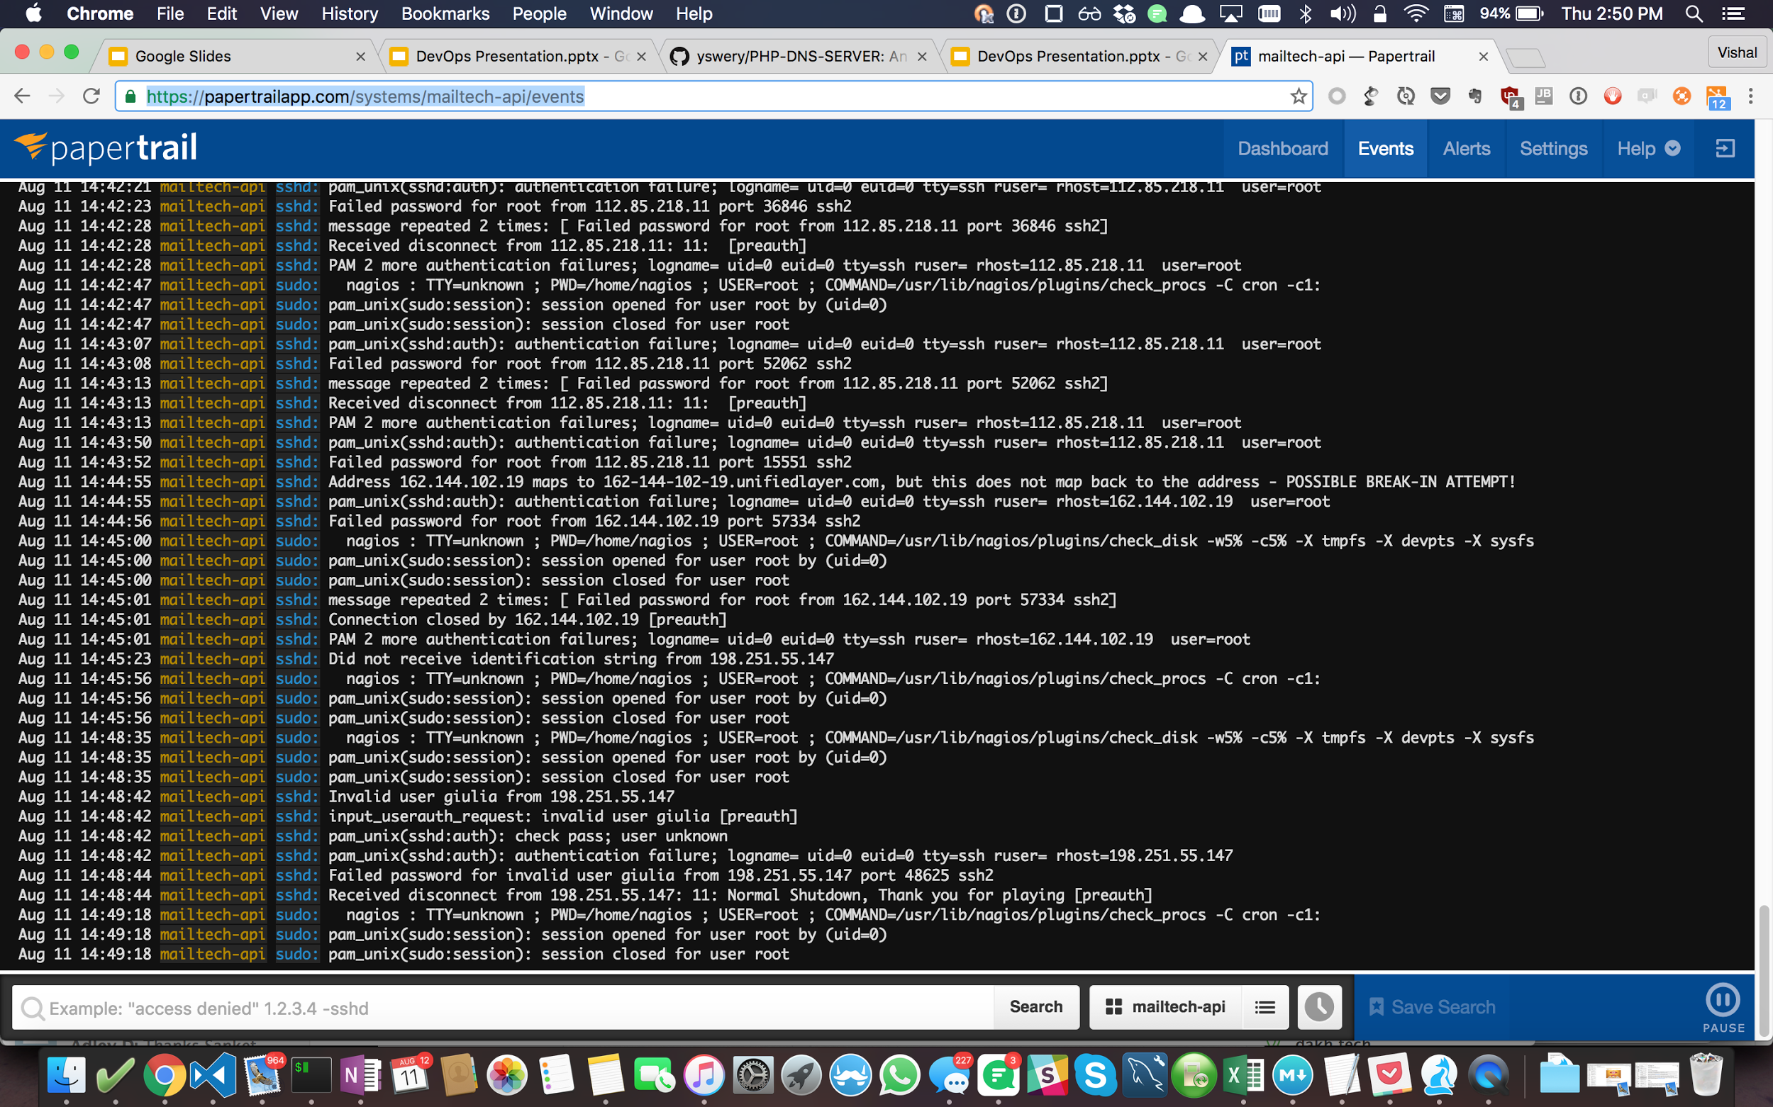
Papertrail

Slide 12
Metrics & Monitoring (Alerts)
Self-Hosted
Ganglia
Graphite + Grafana
Nagios / Icinga
SaaS
NewRelic
Pingdom
PagerDuty

Slide 13
Hooks & Escalation
Slack / Flock
https://flockapi.atlassian.net/wiki/display/FlockAPI/Understanding+Flock+Webhooks
Email
Have a script on the servers which can send emails based on certain state of the application.

Slide 14
Deployment Basics: Web-Servers
Nginx config files
* Adding a site on a Nginx server
server {
listen ip:port;
root_path:
upstream …
}
* Where to read more (http://nginx.org/en/docs/http/ngx_http_core_module.html)
Live demo

Slide 15
App State (avoid)
Stateful
Keeps track of the state of interaction
E.g. cookies : state is send and returned in HTTP Headers
Stateless
No record of the previous interactions.
Each interaction is handled based on the information available for that interaction.
E.g. HTTP

Slide 16
Advanced Deployment: Micro-services and Orchestration
Supervisor
Kubernetes
Mesos
Docker (Swarm)

Slide 17
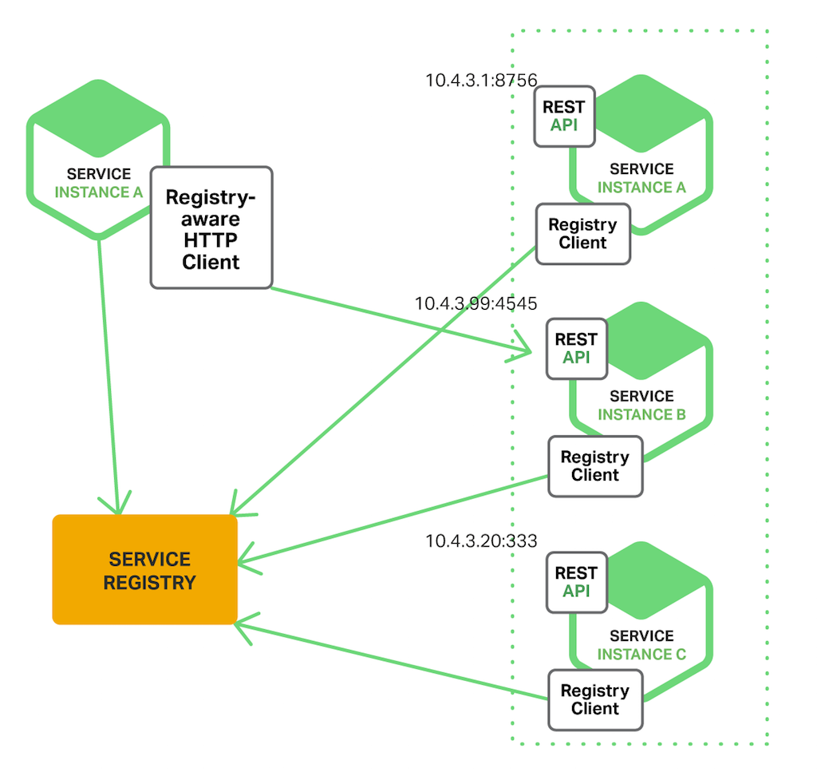
Service Discovery
Client side service discovery

Slide 18
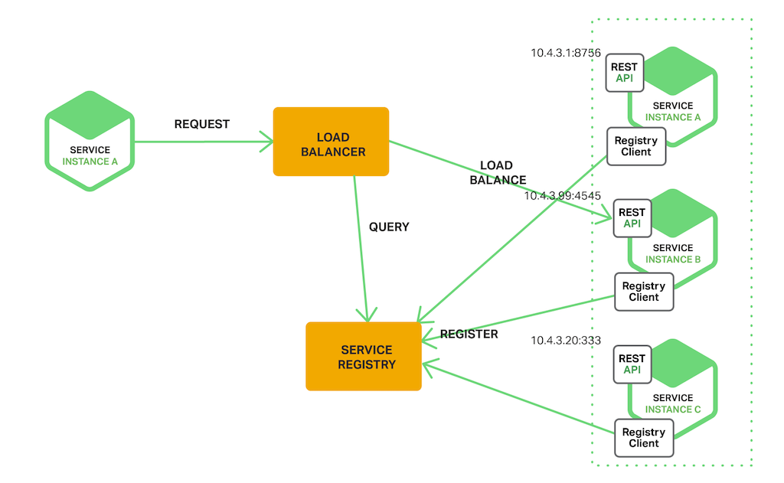
Server side service discovery

Slide 19
Service Registry
Consul
Etcd
Confd
ZooKeeper / Supervisor

